Slide 2
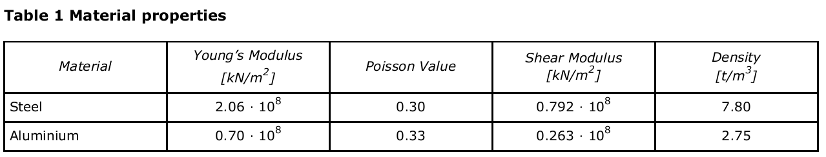
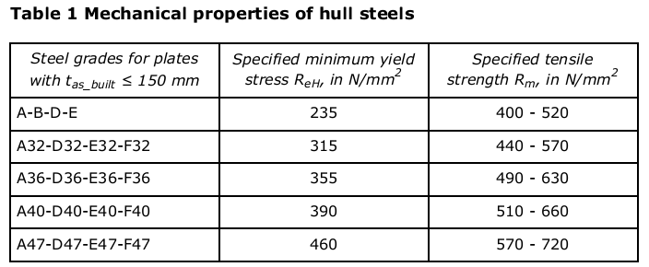
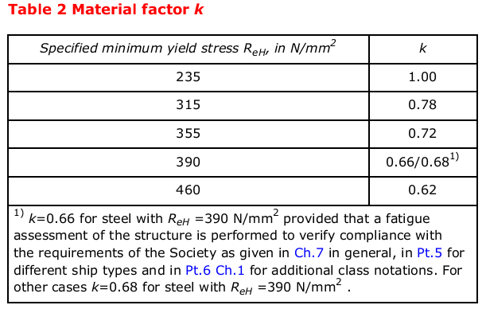
Merial Property
CG-0127, Sec.1.4
RU-SHIP-Pt3, Ch.3 Sec.1, 2.1.3
RU-SHIP-Pt3, Ch.3 Sec.1, 2.2

Slide 3
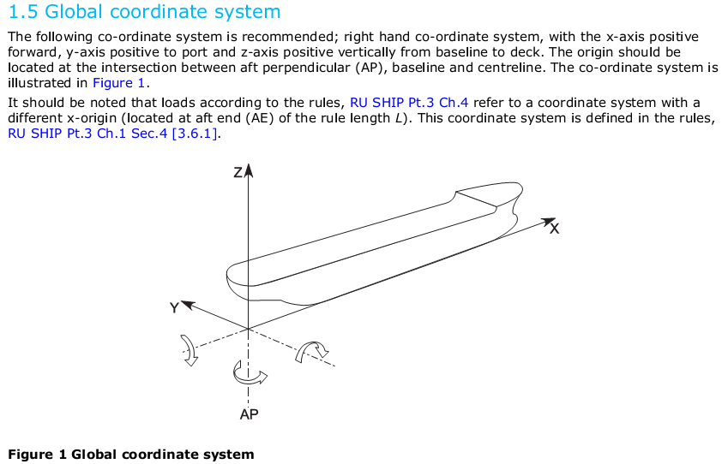
Global Coordinate System

Slide 4
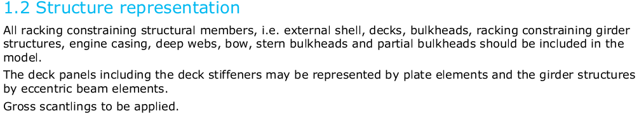
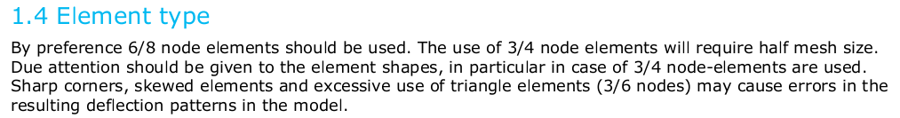
Finite element
CG-0137, Sec.5, 1.2
See CG-0127, Sec.2, 2.4 for model idealisation

Slide 5
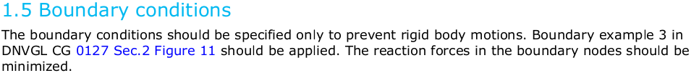
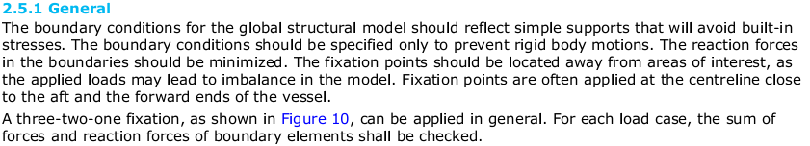

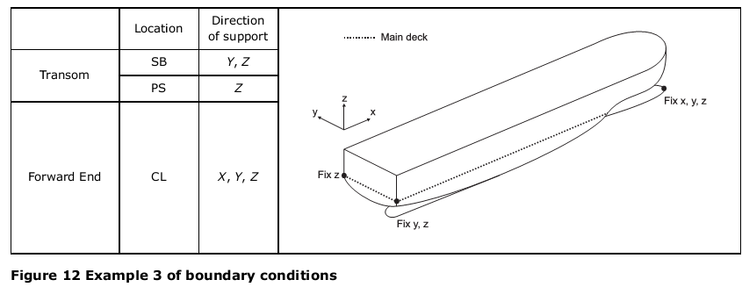
Boundary Conditions
CG-0137, Sec.5, 1.2
CG-0127, Sec.2, 2.5

Slide 6
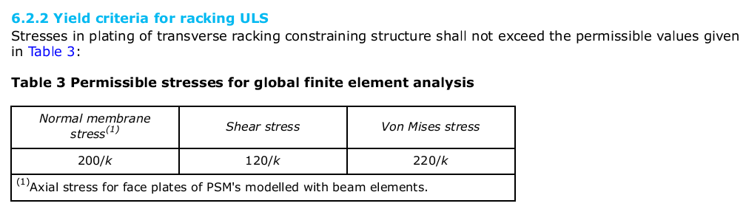
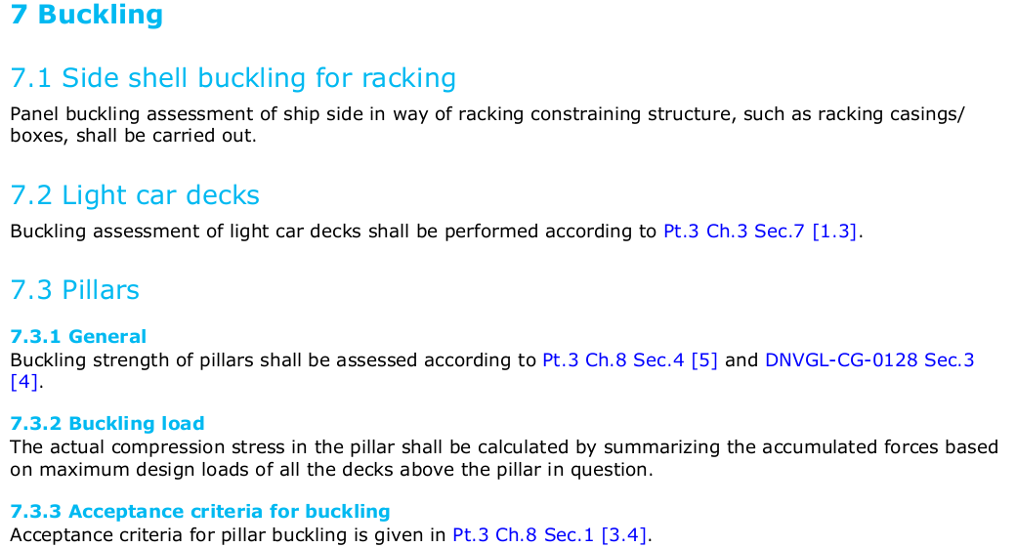
Allowable Criteria(RU-SHIP-Pt5, Ch.3 Sec.2 )

Slide 7
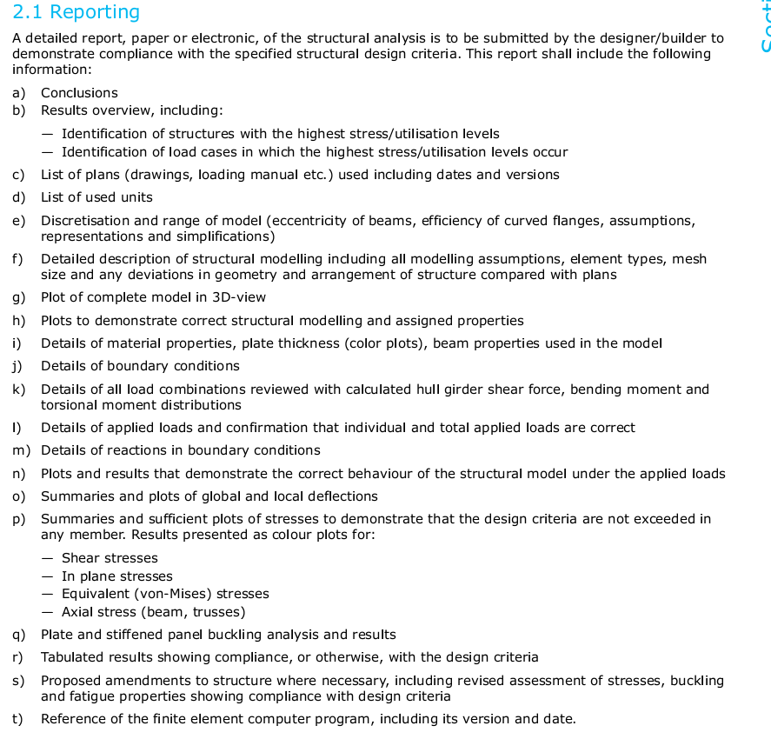
Reporting (CG-0127, Sec.1, 2.1)

Slide 8
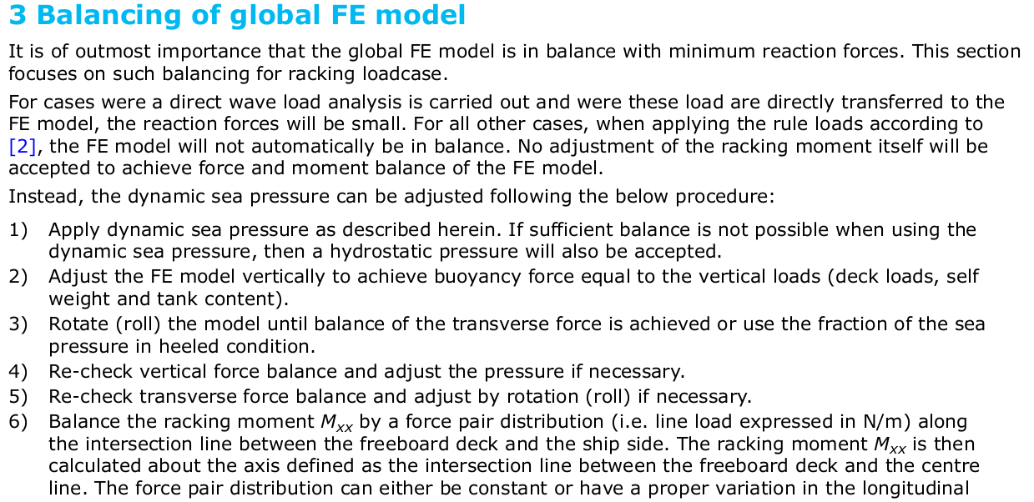
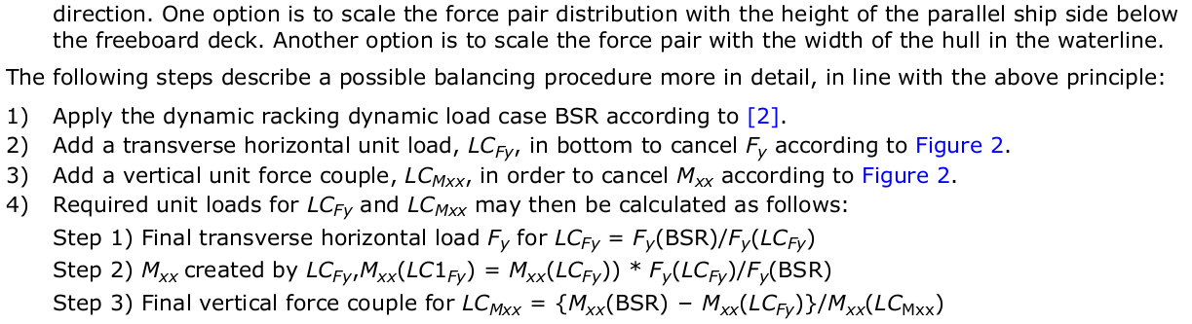
Balancing of Global FE model(CG-0137, Sec5.3)

Slide 9
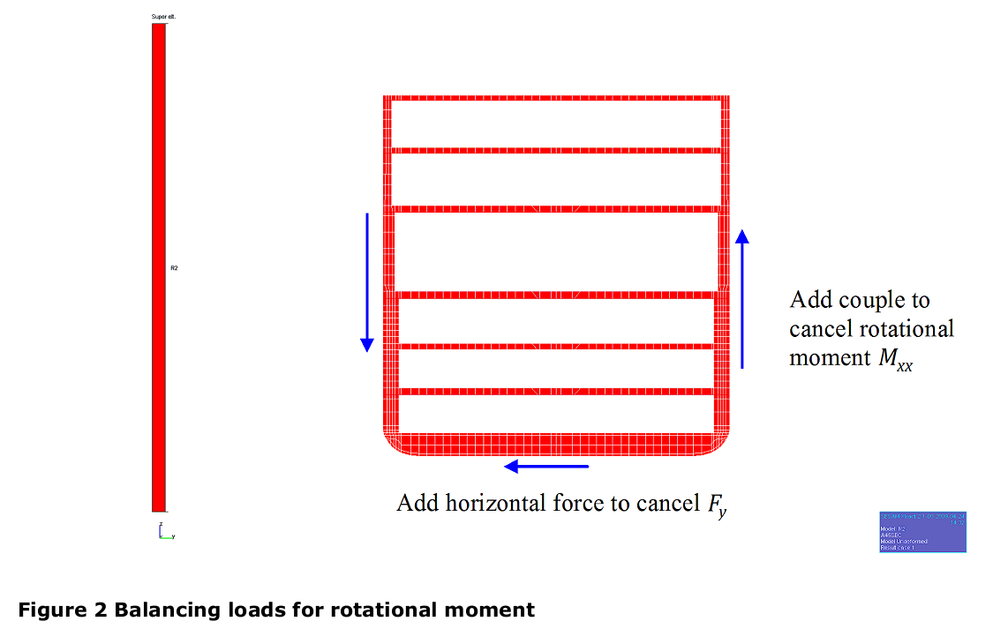
Balancing of Global FE model(CG-0137, Sec5.3)

Slide 10
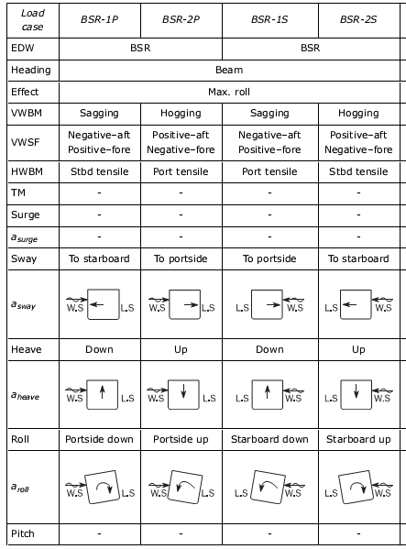
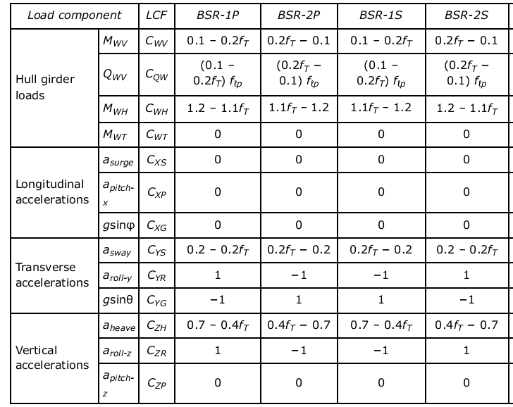
Load Cases and Load Combination
Ship response
BSR load cases:
BSR-1P and BSR-2P: beam sea EDWs that minimise and maximise the roll motion downward and upward on the port side respectively with waves from the port side.
BSR-1S and BSR-2S: beam sea EDWs that maximise and minimise the roll motion downward and upward on the starboard side respectively with waves from the starboard side
Load combination Factor

Slide 11
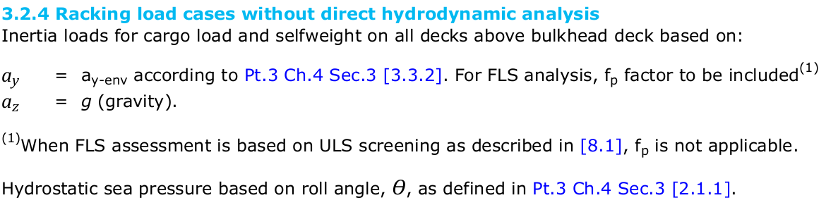
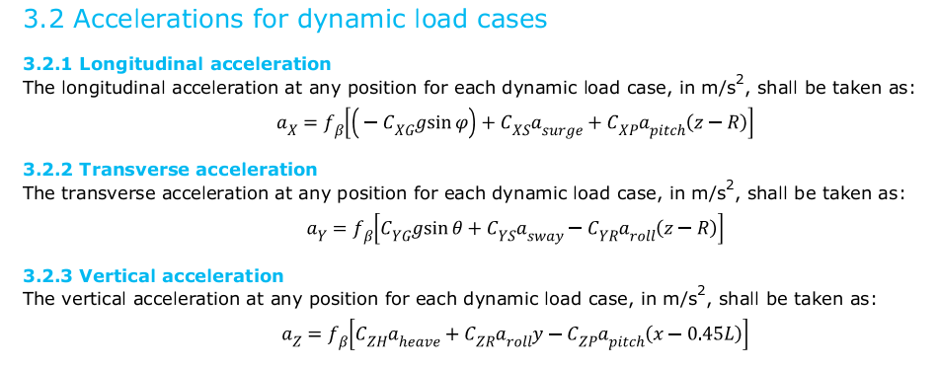
Dynamic Load Cases (Acceleration)
RU-SHIP-Pt5, Ch.3 Sec.2
RU-SHIP-Pt3, Ch.4 Sec.3

Slide 12
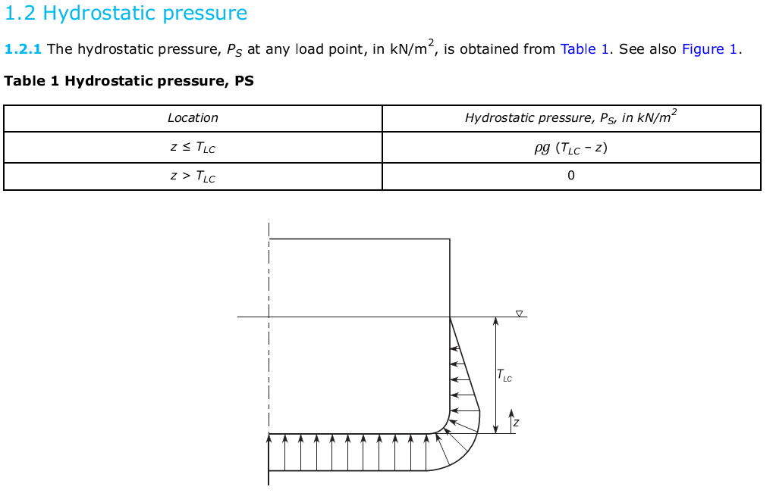
Sea Pressure

Slide 13
Dynamic deck loads
Hydrodynamic Sea Pressure
Static deck loads
Acceleration
RU-SHIP-Pt3.4.3
Hydrostatic sea pressure
Hydrodynamic sea pressure

